Slide 1
Reducing Food Waste Using Data Analytics
A Data-Driven Approach
by Divyashree S N

Slide 2
Introduction
Food waste is a significant global issue with financial, environmental, and social implications.
This project leverages data analytics to identify patterns and causes of food waste and propose actionable solutions.

Slide 3
Objectives
Analyze patterns and causes of food waste.
Quantify financial and environmental impacts.
Provide actionable solutions, such as a Smart Shopping List, to reduce waste.

Slide 4
1. Data Collection
Objective
To gather and organize data that provides insights into food waste
patterns, causes, and impacts.
Data Sources
• Weekly inventory logs of food items purchased and their
quantities.
• Disposal records documenting discarded food items and
weights.
• Purchase history showing shopping habits and frequency.
• Meal preferences and dietary habits for better consumption
tracking.
Data Collected
• Quantity purchased, consumed, and wasted (in kilograms)
Estimated cost of wasted food items.

Slide 5
2.Data Cleaning
Identified missing values and handled them appropriately.
Removed duplicates and standardized formats.
Validated relationships between columns.
Handled outliers using statistical techniques.

Slide 6
3.Data Analysis
Descriptive Analytics:
Identified food categories with the highest waste.
Analysed trends over time.
Diagnostic Analytics:
Investigated causes like spoilage or over-purchasing.
Examined shopping and meal preparation behaviours.

Slide 7
4.Data Visualization
Bar charts to show food waste by category.

Slide 8
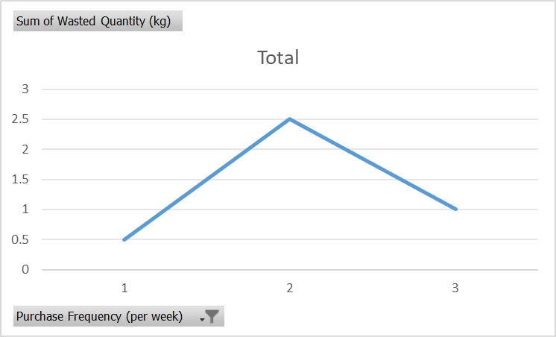
Line charts to display trends over time

Slide 9
Pie charts to highlight financial and environmental impacts

Slide 10
5.Proposed Solution
Implement a Smart Shopping List to track leftovers and reduce over-purchasing.
Use historical data to predict optimal purchase quantities.
Generate dynamic shopping lists tailored to consumption patterns.
Continuously refine recommendations based on new data inputs.

Slide 11
Conclusion
Reducing food waste requires a data-driven approach to identify patterns, understand causes, and implement practical solutions.
By leveraging analytics, we can minimize waste, save money, and reduce environmental impact.

